Slide 1
Lab 2 To implement various Diode clamper circuits and verify its performance using Multi-Sim simulator

Slide 2
Types of clampers:
1. Positive clamper
2. Positive clamper with positive Vt
3. Positive clamper with negative Vt
4. Negative clamper
5 Negative clamper with positive Vt
6 Negative clamper with negative Vt
Assume diode as ideal for all circuit implementation:
(1) Vi input sinusoidal of 30Vpp and Time period (T) =1ms
Vref = 4 V
Choose 1N4001 Diode
Resistance R= 100 K and C= 1 uF

Slide 3
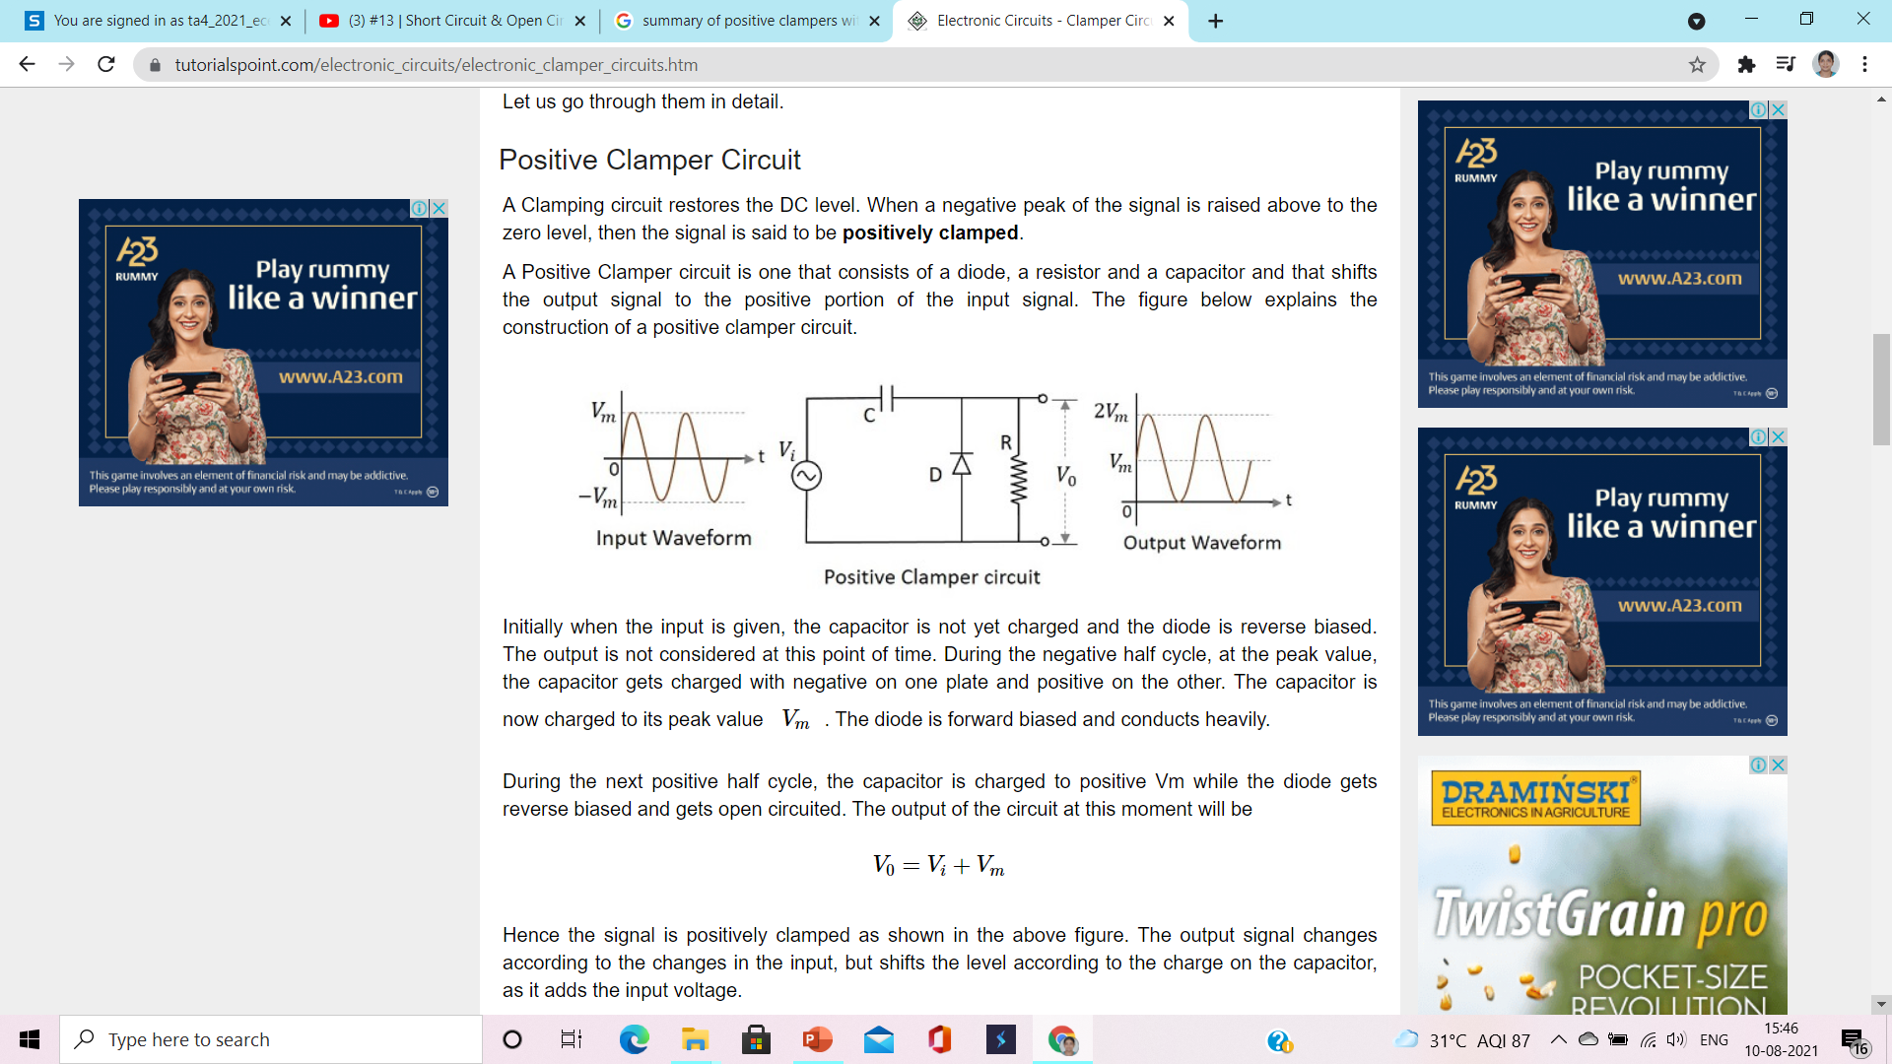
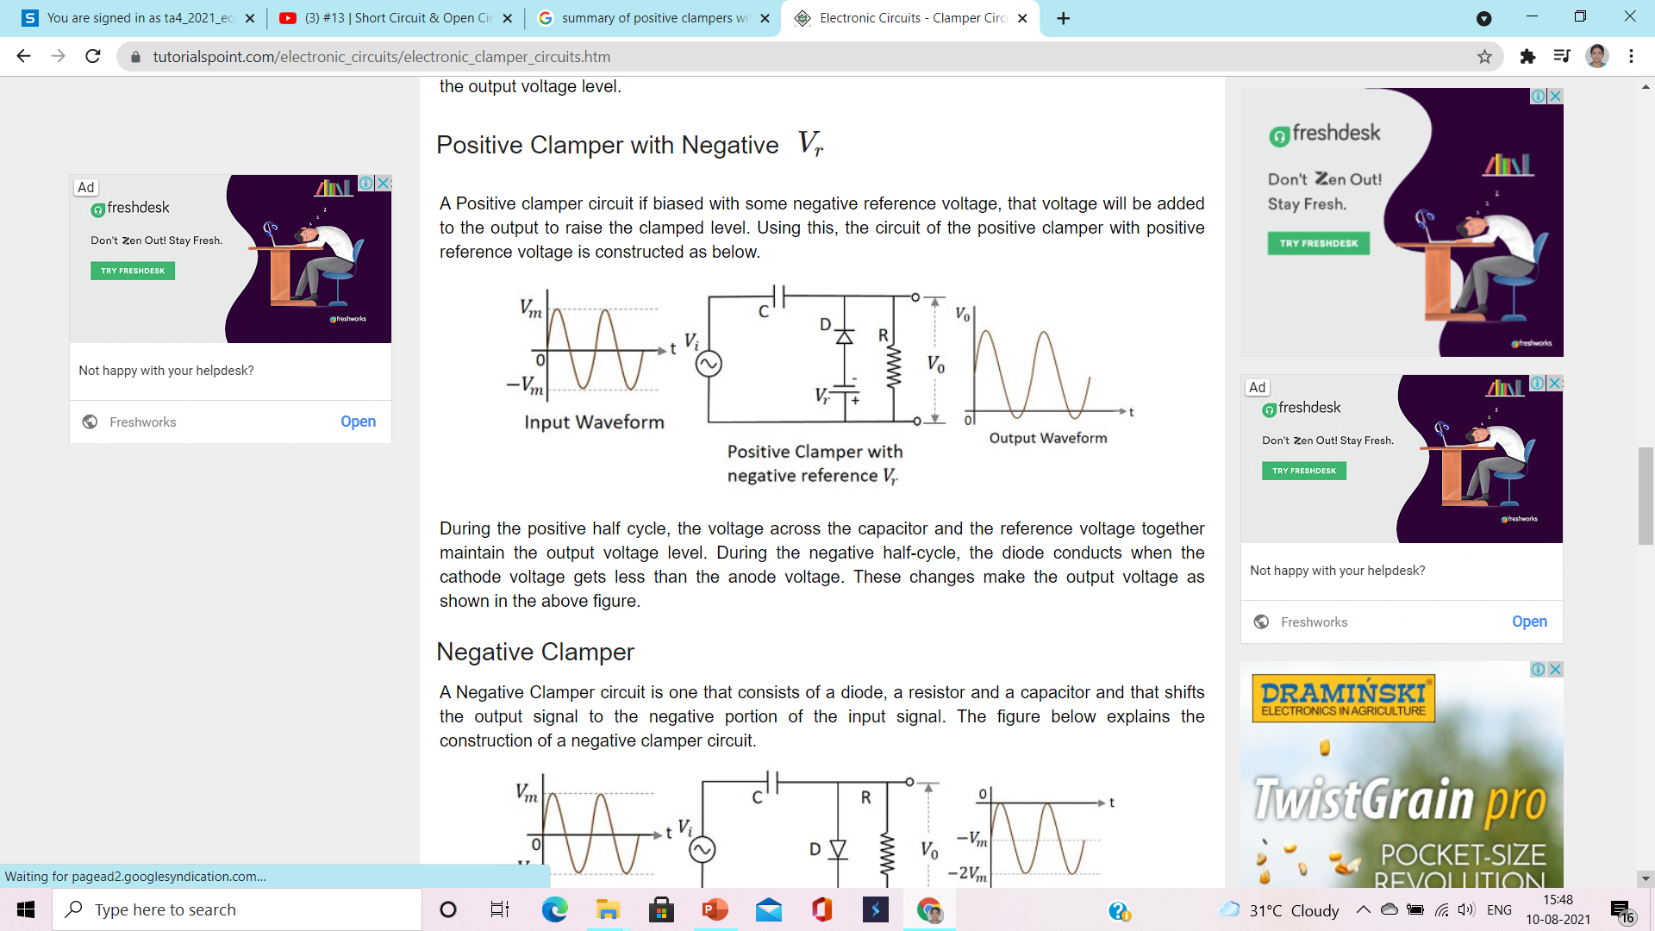
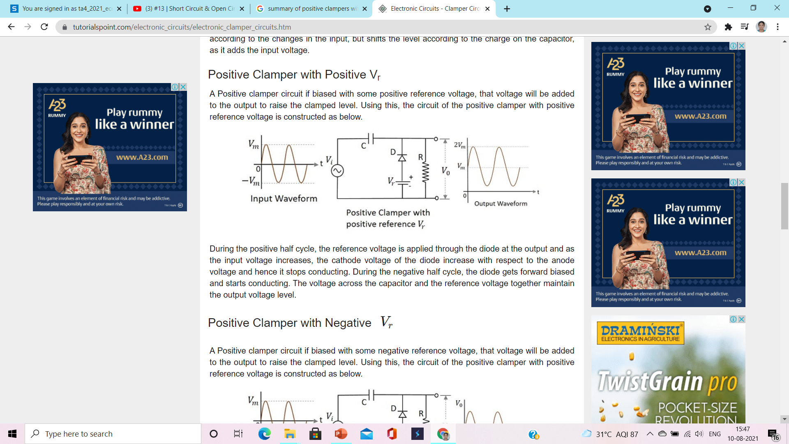

Slide 4
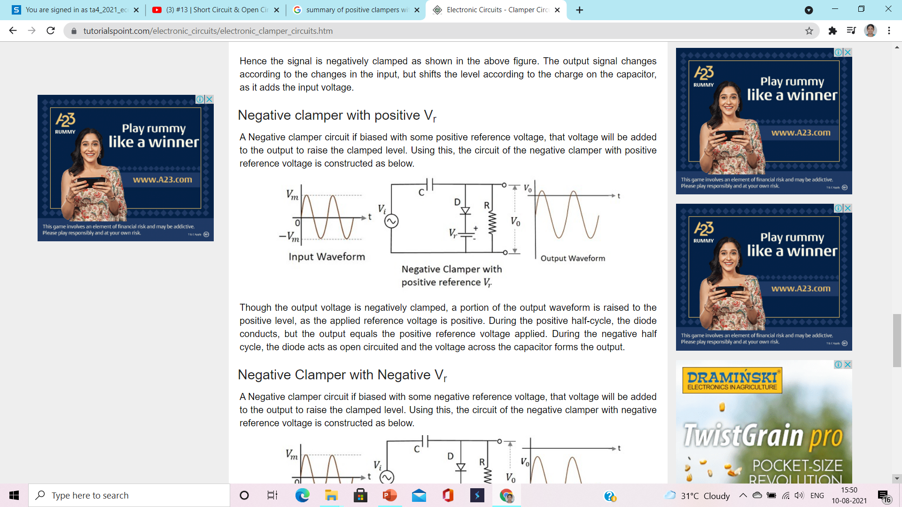
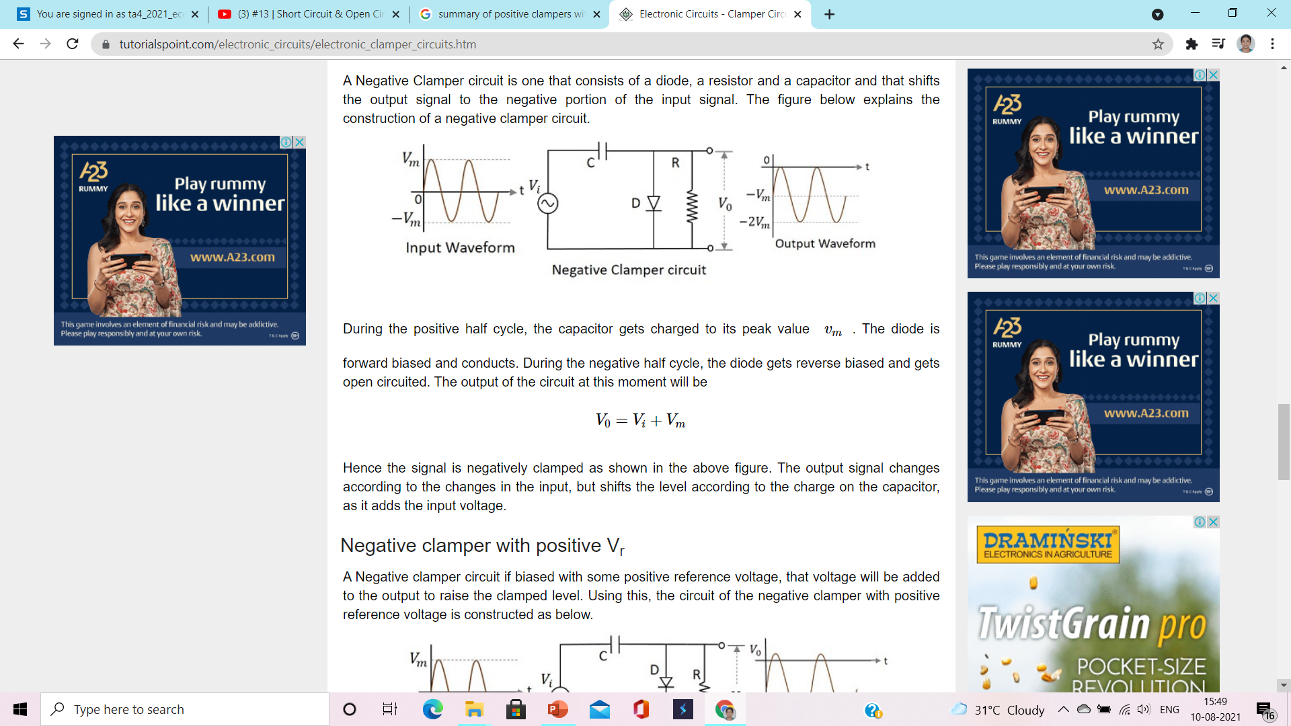
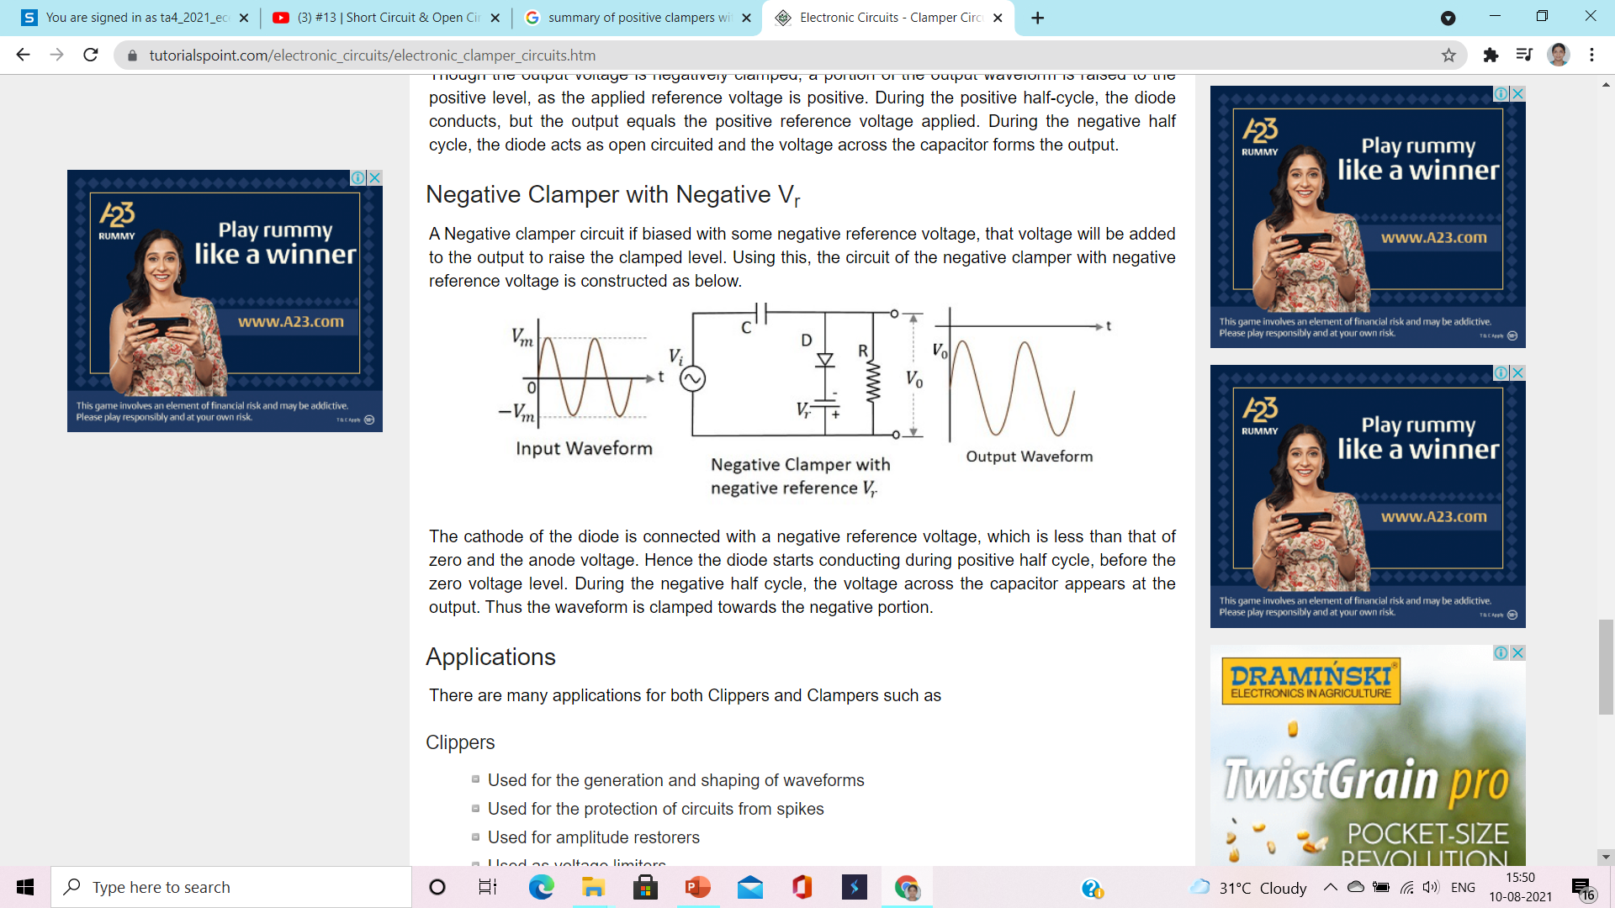

Slide 5
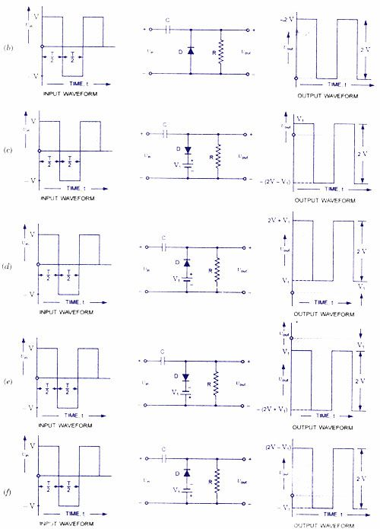
Assignment 2

